Slide 1

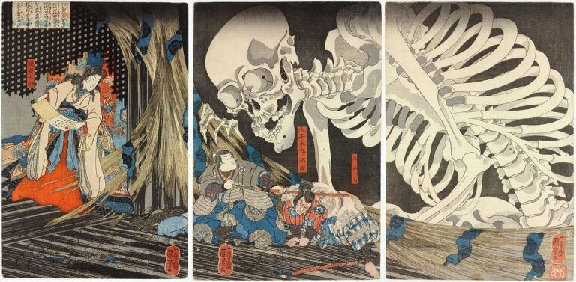
Night of the living Yōkai

Slide 2
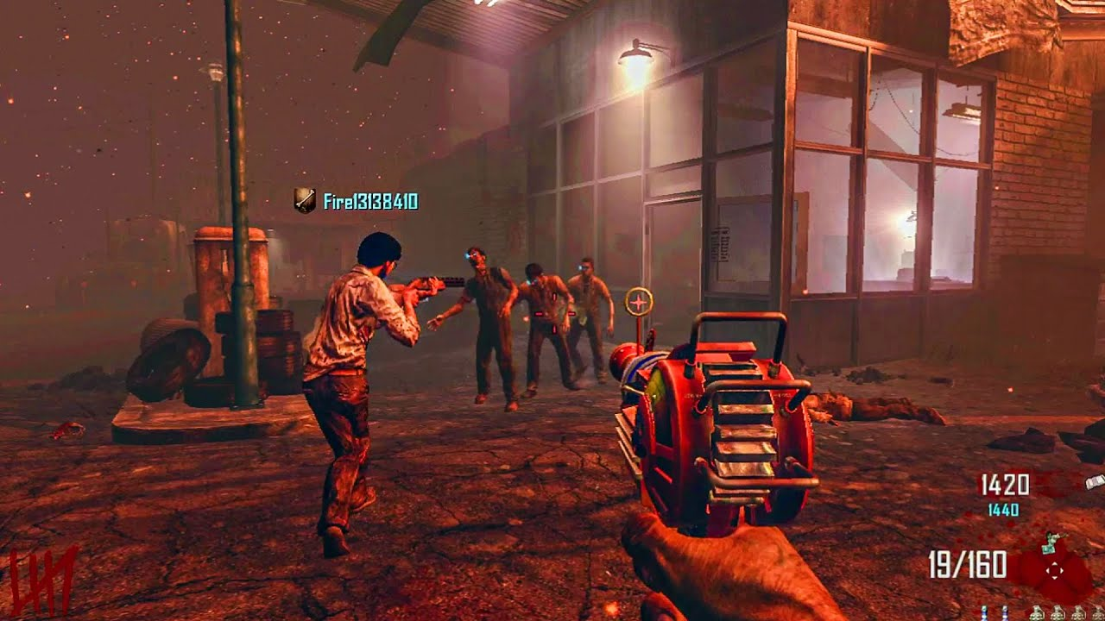
Core Ideas
Core Concept
Core Gameplay Loop
Wave-Based First-Person Combat.
Player starts in an abandoned shrine yard.
Waves of yokai spawns around the player and need to be defeated.
Interaction with good yokai for buffs.
Progression through unlockable weapons and abilities.
The player spawns into the game equipped with a katana.
After 5–10 seconds, the first wave starts.
Each wave ends when all yokai are defeated.
As waves progress, the player will have a random chance of interaction with a good yokai for buffs or random boss spawns (identified by bigger asset models).
When a wave ends, the player will earn points based on how many kills they have and will have time to use them for unlocking abilities or other weapons.
The game ends when you die.

Slide 3
Task Checklist
Environment & World Systems
User Interface
Shrine Yard landscape design.
Weather system
AI spawn system.
Round base system.
Score keeping system.
NPC interaction system.
Display player’s health.
Display wave counter.
Display abilities’ information.
Display current weapon in hand.
Display secondary weapon.
Display main menu and pause menu.
Combat
Audio
Enemy AI (attacking, walking, targeting) behavior tree.
Player weapon swapping and attacking system: Gohei, Hama Yumi(bow), and Kusanagi no Tsurugi (sword).
Buff system (health regen, speed, damage, and damage resist).
Ability system
Damage & Health system.
Basic player’s audio.
Basic enemies’ audio.
Environment audio.
Basic combat audio.

Slide 4

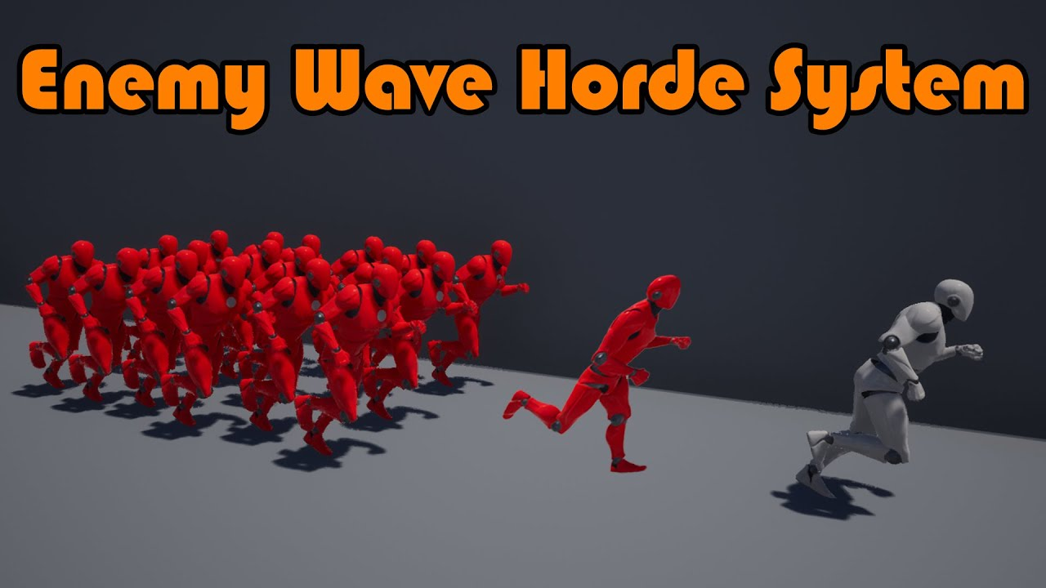
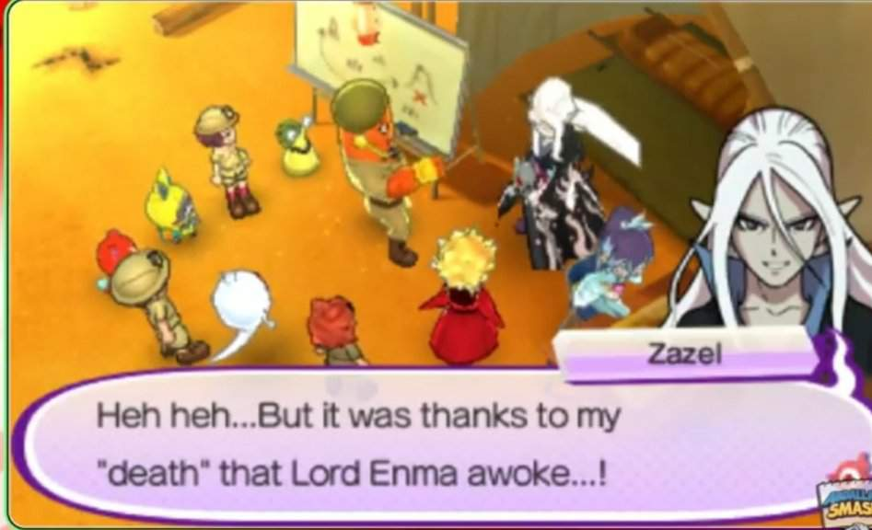
need to research
Ability system.
Ai spawning and wave scaling logic.
Weapon swapping logic.
Audio triggers when an event happens.
Yokai walking animation patterns.
Audio for player and ai movements.
Might need Help On
Advanced Ai pathfinding around the shrine.
Audio/text Lines from NPCs.
Smooth environmental lighting.
Making custom artwork.
Overall combat system.

Slide 5
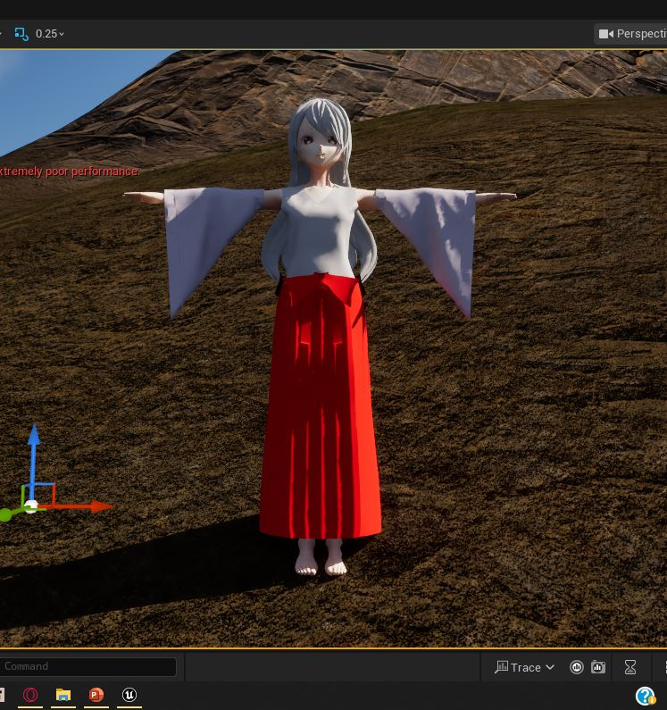
required Assets
Type | Name
Player | Shrine Maiden model.
World | Shrine, trees, plants, landscape, rocks, rain, Oda Era houses and buildings.
Enemies | 6 different types of yokai. (2 will be interactable)
weapon | 3 different types of weapons. (katana, bow, Gohei)
Sounds | Running, attacking, enemies sounds, raining sounds.
Extra Features That On my Wishlist.
Lore Collectables that is about the Main Character
Extra detailed wave spawning that have unique boss abilities.
Option to gain respect from the good yokai and they would join your party.
Main Character

